Slide 1
FINAL PROJECTS
COMPUTER INFORMATION TECHNOLOGY
CV RESUME
SPEED SHEET
ANALISE

Slide 2
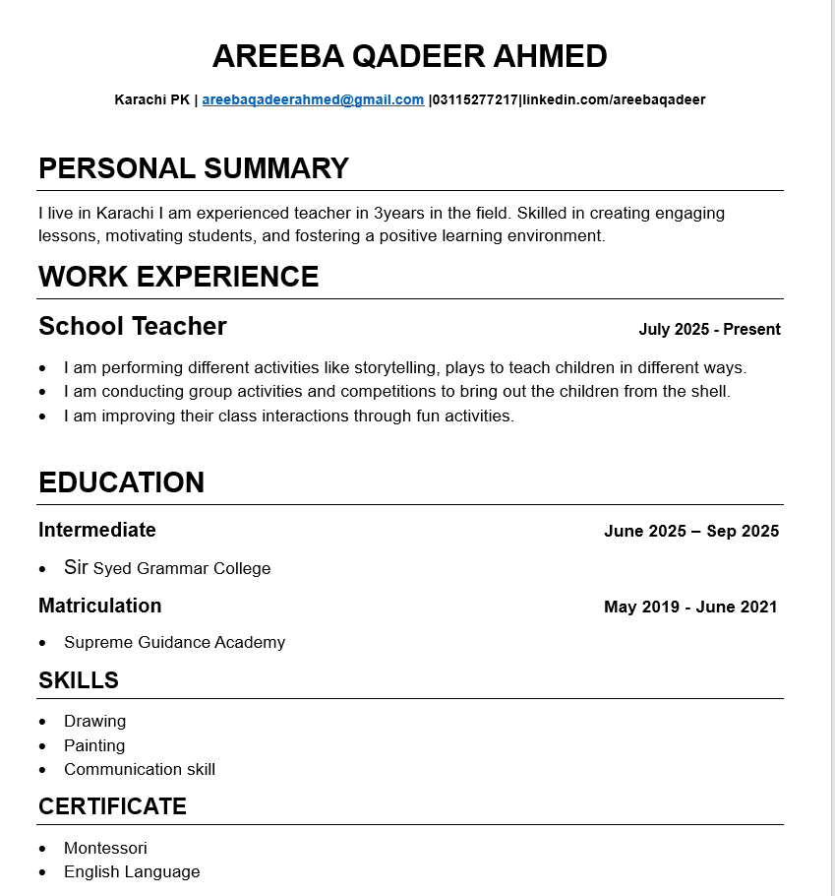
My resume
A resume is a summary of My skills, experience, and education .It highlights my qualifications .It includes contact details, work history, and achievements.

Slide 3
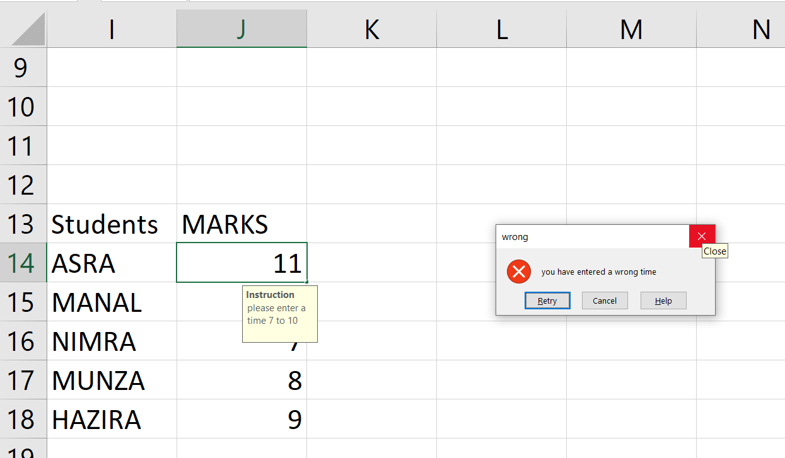
Data validation
Data validation is the process of ensuring data is accurate and reliable. It checks that data is correct, complete, and meets required formats. Validation helps prevent errors in data entry or processing. It can be done manually or automatically using rules.

Slide 4
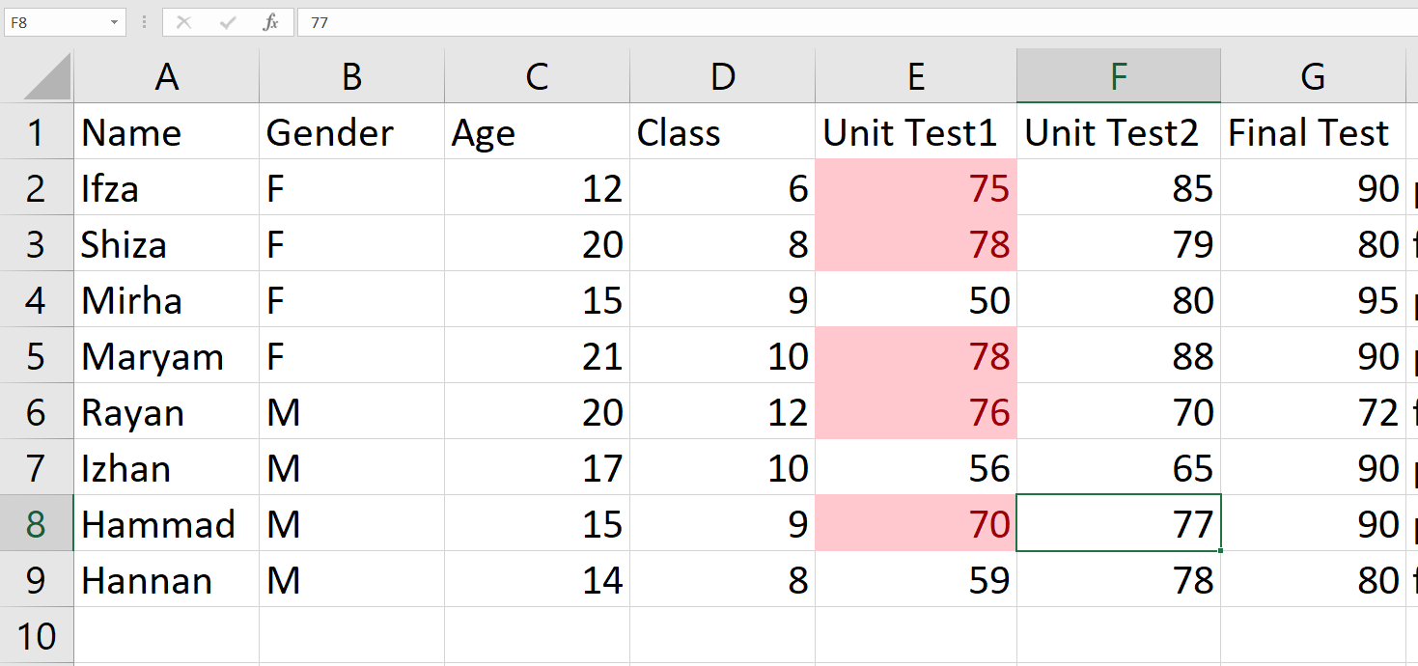
Conditional formatting
Conditional formatting is a feature used to change the appearance of cells based on their values. It helps highlight important data, trends, or exceptions. Rules are set to apply formats like colors, icons, or bold text. Common in tools like Excel and Google Sheets. It improves data visualization and quick analysis.

Slide 5
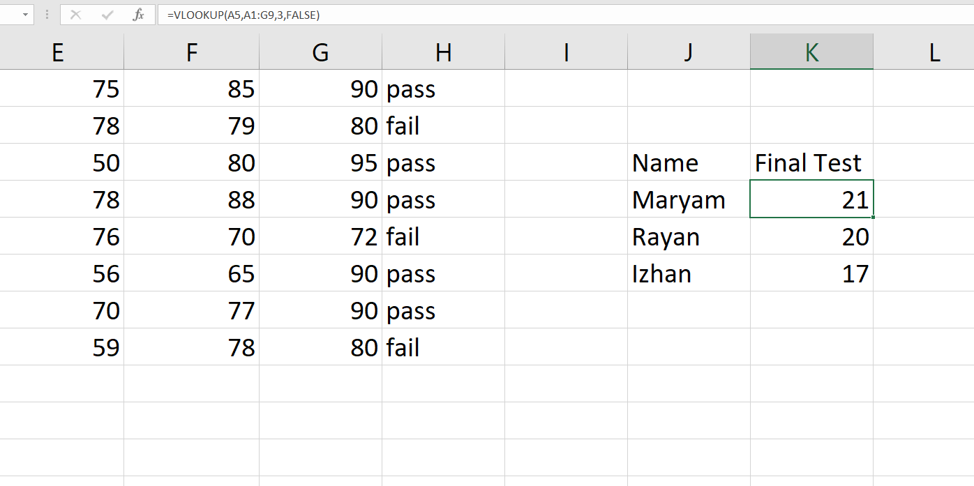
VLOOKUP
VLOOKUP is a function in Excel used to find data in a table. It searches for a value in the first column of a range. Then it returns a value in the same row from a specified column. VLOOKUP is useful for retrieving related data quickly. It's commonly used for matching and comparing data sets.

Slide 6
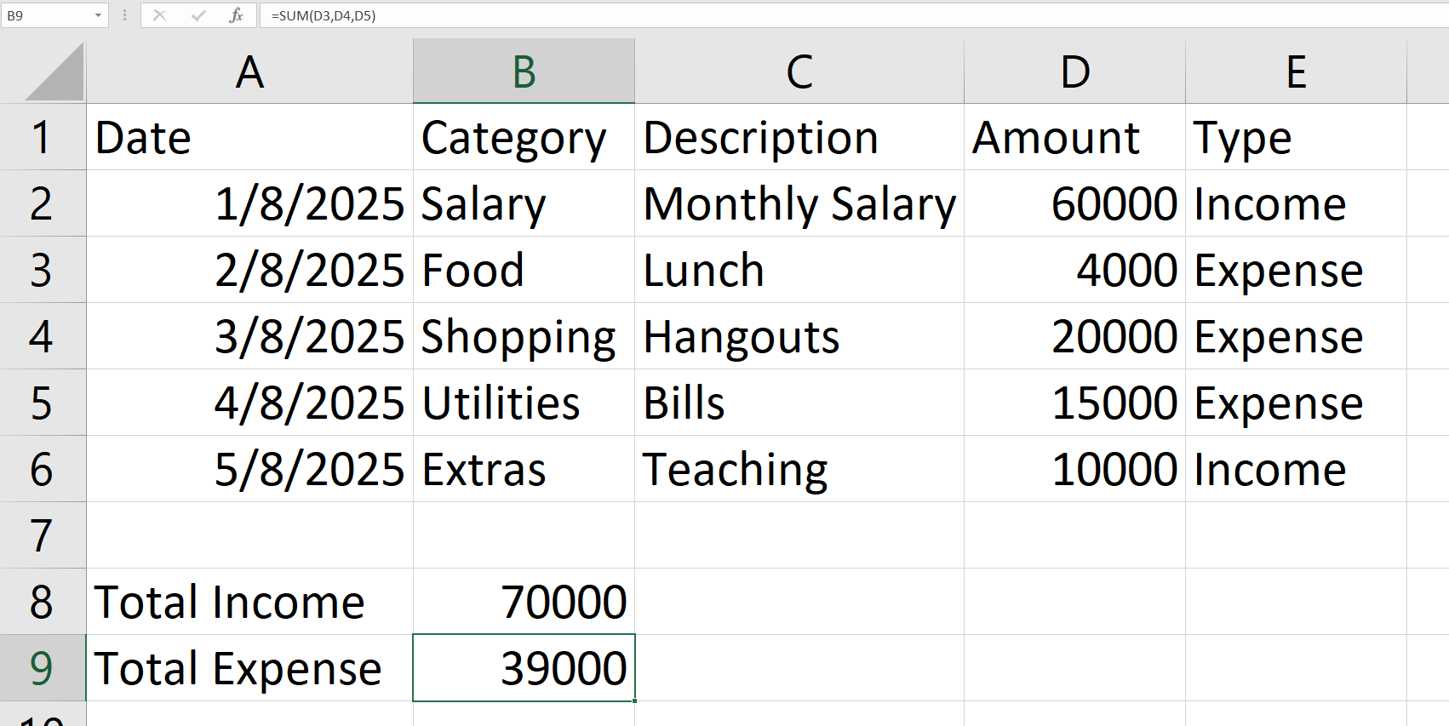
Sum in excel
Sum is an Excel function used to add numbers together. It calculates the total of selected cells or ranges. It simplifies adding large sets of values quickly. Widely used for financial, statistical, and general calculations.

Slide 7
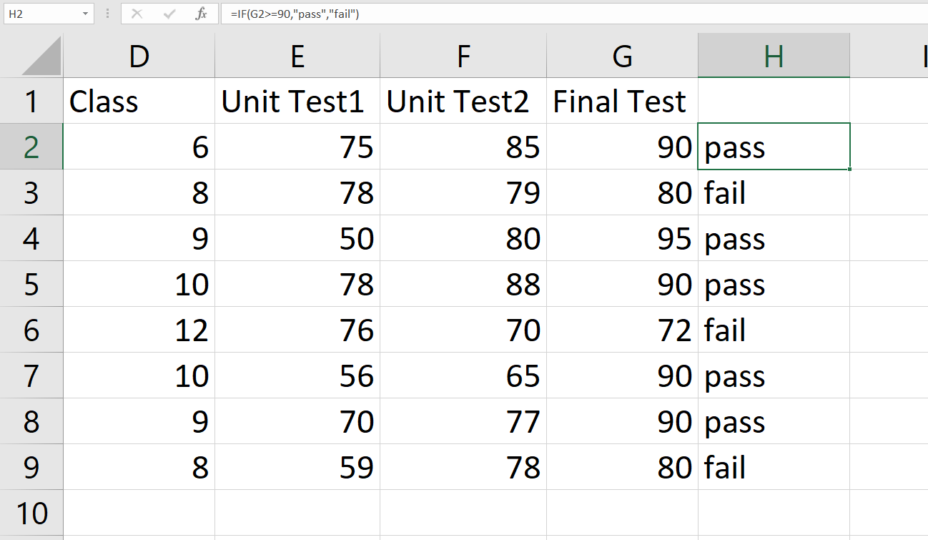
If in excel
IF is a logical function in Excel used to make decisions. It returns one value if a condition is true, and another if false. It helps automate tasks based on specific criteria. Commonly used for comparisons and conditional outputs.

Slide 8
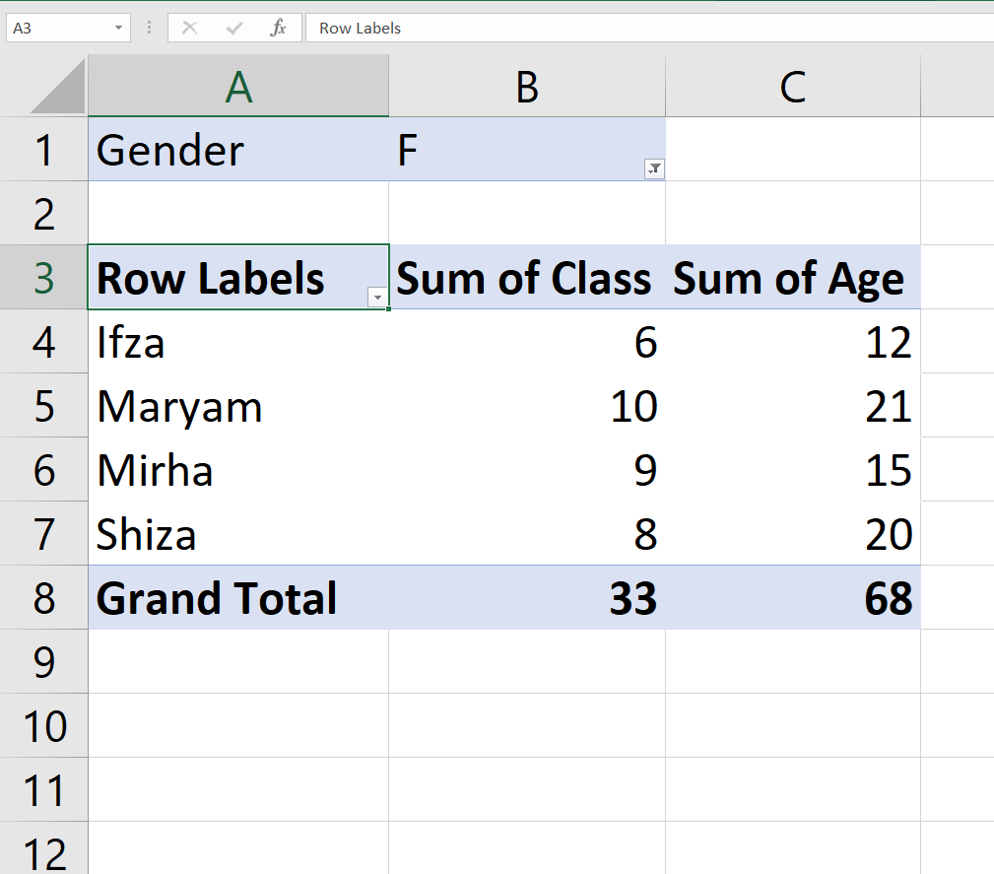
Pivot Table
A Pivot Table is a tool in Excel used to summarize and analyze large data sets. It allows you to reorganize data by rows, columns, values, and filters. You can quickly find patterns, totals, and comparisons.

